Slide 1

Bauchi State
Investment Opportunities
2023

Slide 2
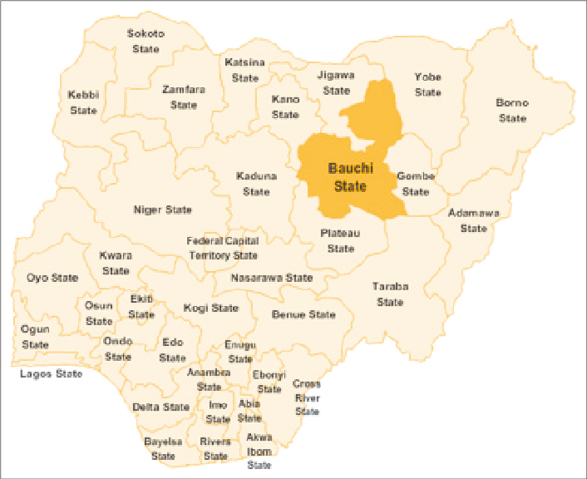
Map of Nigeria showing Bauchi State of Nigeria

Slide 3
About Bauchi State…..
Bauchi State was created in 1976 and located in the North Eastern part of Nigeria. It is made up of 20 local government councils
It occupies a total of 49,259.01 square KM land area and this represents about 5.3% of Nigeria’s total land mass
The State has an estimated population of over 7.6 m with average growth rate of 3.3% annually. Strategically, the 20-65 years age bracket constitutes 41.2% of the population. The GDP stands at $4.7billion with a par capita income of $983

Slide 4
Bauchi State….
Bauchi State has 55 ethnic groups, each with fascinating cultures and traditions and speak varied languages with Hausa language as the commonest among them but English is an official dominant language.
Topographically, the western side of the state is dominated by hill ranges of the Jos Plateau depicting characteristic extensive plateau surface and volcanic extrusions.
River Gongola is the dominant river which originates from Jos and traverses five local governments with numerous tributaries.
The State is located between latitudes 9031 and 12031 North of Equator. While on the East of Greenwich Meridian , the State lies between longitudes 8051 and 110

Slide 5
  Key Strategic Sectors of the State
  Key Sectors being promoted being promoted for investment are:
    Agriculture
    Solid Minerals
    Brownfield investments
    Tourism
    Other sectors with investment opportunities
    i. Power
    ii. Health
    iii. Education
    iv. Housing
    v. ICT
    vi. Water
    vii. Waste Management
    viii. Transport

Slide 6
Creating Favourable and Conducive Business Environment in the State
Bauchi State government recognizes the importance of favorable business environment and we worked assiduously towards improving the business environment in the State
The business environment in the State has recorded a remarkable improvement from the 6th position in 2018 to 4th position in 2021 among the 36 states of Nigeria on the World Bank Group’s Ease of Doing Business ranking (Doing Business in Nigeria Database World Bank, 2021).
We will not relent as we will work to continuously improve the business environment not only to improve the attractiveness of the State to private investors but to also make the State the most business friendly State in Nigeria

Slide 7
Investing in Bauchi State
Bauchi State has established a ONE-STOP INVESTMENT SHOP, in at BAUCHI INVESTMENT CORPORATION(BIC)
www.investinbauchi.bu.gov.ng
BIC is ever willing to attend to investors enquiries, attend to the concerns of existing investors, partner with prospective investors in developing investment projects and provides facilitation and after care services to all classes of investors.
The Corporation implements the investment policy of the State
The Corporation catalogues investment opportunities in the State, specific investment incentives the State offers and disseminates the information to all stakeholders
It also identifies emerging opportunities in the local, national and international markets for profitable investment
BIC also gives priority attention to the growth and development of SMEs in the State

Slide 8
10 Steps to Starting a Business in Bauchi State
PROCEDURE REQUIRED | ORGANIZATION RESPONSIBLE
To reserve a unique company name for the new business in Bauchi State | Corporate Affairs Commission Office in Bauchi
2. To prepare incorporation documentations and Stamp duty | Corporate Affairs Commission Office in Bauchi
3. To sign declaration of compliance | Bauchi State High Court
4. To pay incorporation fees | Any branch of a commercial bank in the State
5, To register a company | Corporate Affairs Commission Office in Bauchi
6. To make a company seal | Any registered seal maker
7. To Register for income tax and VAT | Federal Inland Revenue Service Bauchi Office
8. To register for PAYEE | Bauchi Inland Revenue Service
9. Inspection and Registration of Business Premises | Bauchi State Ministry of Commerce and Industry
10. To register and obtain Business Premises Permit | Bauchi State Ministry of Commerce and Industry

Slide 9
SECURITY AND SOCIAL COHESION
Security Situation and Measures taken
Security in Bauchi State is very good. Compared to the rest of north eastern region of Nigeria, the State has never been at the center of any form of insurgency and has, however, provided sanctuary to over a million peace-seeking people.
The State Government evolved strategies and initiatives to stem any form of security threat
These measures are:
1. Effective intelligence gathering on security from every nooks and crannies of the State.
2. Effective Community Policing across the State.
3. Engagement of private security organizations to guard, monitor, gather information and report on any security threat in the State.
4. Restructuring and registration of all faith-based organizations in the State.

Slide 10
Key sectors being promoted for Investment Drive
Agriculture
Solid Minerals
Brownfield Investments
Tourism

Slide 11
Investment Opportunities in the Agricultural Sector
Investment Opportunities in
Agricultural Sector
Large Scale Commercial Agricultural Production-
Soya bean
Sesame seeds
Livestock
Rice production
Pasture Production-
Development of Priority Value Chains (Agro-Food Processing)-
Cereal and Legume: Maize, Rice, Millet and Groundnuts
Oil Seeds: Sesame
Livestock: Sheep, Goat and Cattle (Meat processing)
Agro-Forestry: Gum Arabic, Jatropha, Tamarind, Mango and Date Palm
Fisheries
Poultry
Gamba grass etc

Slide 12
Policy Drive for the Sector
  It is the strategic focus of this government to restructure the agricultural sector
  The effort is geared towards systemic shift from subsistence farming to mechanized commercial agriculture through crop intensification, technological advancement, value addition and critical infrastructural development.
  The State also has a policy towards developing the exports potentials of agriculture in order to contribute towards the diversification of the exports base of the country
  The thrust of the Agricultural Policy of the State is promotion of private sector participation and active engagements with development partners to promote commercial production of agro-produce to strengthen food security, supports agro-allied industries and exports markets

Slide 13
Agricultural Sector…….
SECTORAL INCENTIVES ON AGRIC VENTURES
Availability of Land for agricultural purposes
Opportunity for establishing of agro- processing industries
Pioneer status relief could be enjoyed for certain period of time for specific agricultural and agro-processing activities
Other Tax Sweeteners such as 95% Capital Allowance, Zero Import Duty on equipment and machinery, Lower Corporate Income Tax rate, Investment Relief Allowance etc. are also available for investors to take advantage of.
Investors will also benefit from ready supply of technically skilled and unskilled workers as the State is a host to various federal technical institutions such as the Federal University of Technology(ATBU), Federal Polytechnic besides the State owned higher institution of learning such the Bauchi State University, Bauchi State Polytechnic among others.
Very receipted and hospitable host communities

Slide 14
SOLID MINERALS
An overview….
Nature has endowed Bauchi State with high deposit of untapped minerals.
The Government has the ultimate aim of making Bauchi State a referral point for mining destination and hub for investment in solid mineral exploration and exploitation in Nigeria.
Recent studies and research have shown that there are over 60 varieties of minerals in the state.
Unfortunately the sector is presently dominated by artisanal miners

Slide 15
SOLID MINERALS
An overview…..
Categories solid of mineral resources in the State:
METALIC; Lead/Zinc, Cassiterite, Tantalites, Woftromite, Iron Ore, Bismuth, Rutile etc
INDUSTRIAL; Kaolin, Limestone, Gypsum, Clay, Quarz, Silica sand, Graphite etc
GEMSTONES; Beryl, and tourmaline etc
EVAPORITES; Salt and Brine etc
Also, the State is blessed with substantial Hydrocarbon/Petroleum and Uranium deposits.

Slide 16
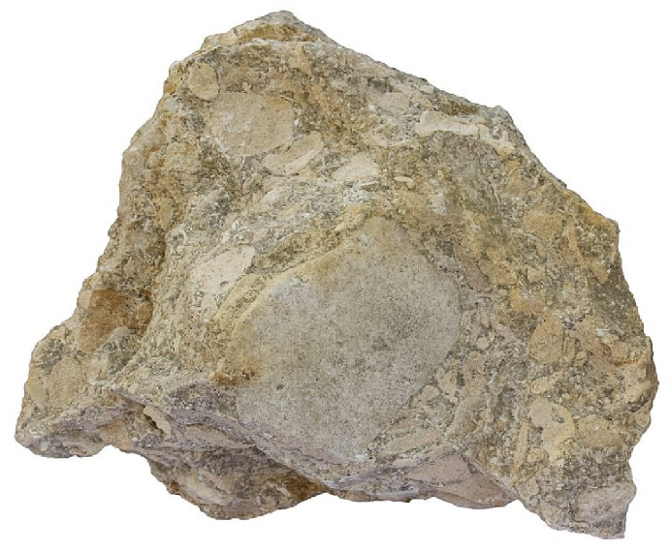
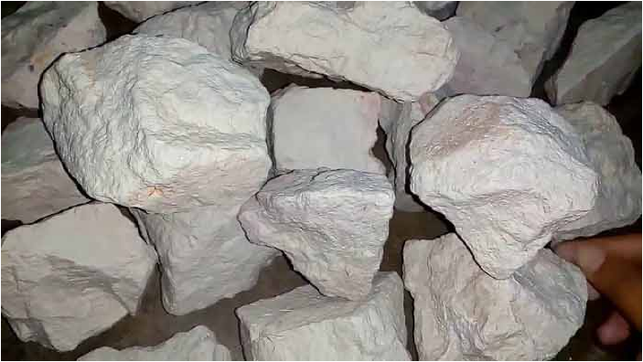
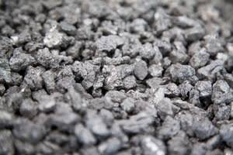

A few of the Minerals found in Bauchi State….. Clockwise below are (a) Limestone….(b) Kaolin….(c) Titanium….(d) Gold….
Limestone
Kaolin
Titanium
Gold

Slide 17
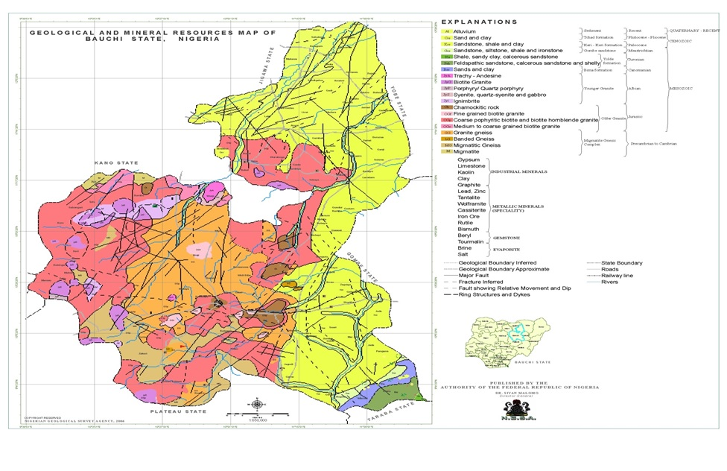
Geological and Mineral Resources Map of Bauchi State

Slide 18
Reforms introduced in solid minerals development
The Bauchi Mining Synergy and Exploration Limited (BAMSEL) was incorporated by the Government as a Special Purpose Vehicle (SPV) to promote PPP in the following areas:
- promote private investment in downstream value chain
- investment in long-term exploration
either solely or in partnership with the State

Slide 19
SOLID MINERALS…..
SECTORAL INCENTIVES ON SOLID MINERALS
Tax Exemption for the first three years of operation
Custom and Import Duty Exemption on plant, machinery, equipment and accessories used exclusively for mineral mining related activities.
Tax Relief at 20% for Companies Income Tax instead of 30%
95% Accelerated Capital Allowance on Capital Expenditure in the first year of use of the asset
Investment Tax Relief Allowance
Provision of land other than mining site at concessionary rates
A modest Royalty fee to the State Government
Availability of technically skilled and unskilled workers as the State is a host to various federal technical institutions such as the Federal University of Technology(ATBU), Federal Polytechnic besides the State owned higher institution of learning such the Bauchi State University, Bauchi State Polytechnic among others.
Very receipted and hospitable host communities

Slide 20
Bauchi State Invites Expression of Interest….
Investment
Opportunities
1. Investment in a structured and certified Geological Survey to ascertain the type, quantity, quality and commercial viability of mineral deposits in the State
2. Investment to set up Mining industries / Exploration companies on any of the mineral lines
3. Investment in setting up Mineral based Processing Companies to produce value added goods for domestic consumption and exports e.g.
- Proposed Gwana Cement Company
4. Setting up a raw and processed Mineral Buying Center

Slide 21
c. Brownfield Investments (Multi-Sector brownfield opportunities) It is the cardinal objective of the present administration to attract private investment in order to resuscitate these industries either through partnership or outright divestment
COMPANY NAME | SECTOR
Bauchi Meat Products Company | Agro/Meat Processing
Arewa Ceramic Company Ltd | Solid Mineral
Wikki Hotel Limited | Hospitality
Zaranda Hotel Ltd | Hospitality
Galambi Cattle Ranch Ltd | Livestock
Bauchi Plastic Recycling Company | Manufacturing
Bauchi Plastic Company | Manufacturing

Slide 22
d. TOURISM SECTOR
An overview
Bauchi State is endowed with great tourism potentials and leisure and recreational sites that are investment friendly.
Based on this unique natural endowment, Bauchi State is tagged as “Pearl of Tourism” and “Home of Peace and Hospitality”.
Key eco-tourism attractions are:
1. Wildlife Parks
2. Sites and Monuments
3. Cultural Festivals

Slide 23
Tourism Sector… OPPORTUNITIES
*Investment Opportunities in
Tourism Sector:
PPP in operation and management
Ecotourism development
Infrastructure development in the Reserve and Park.

Slide 24

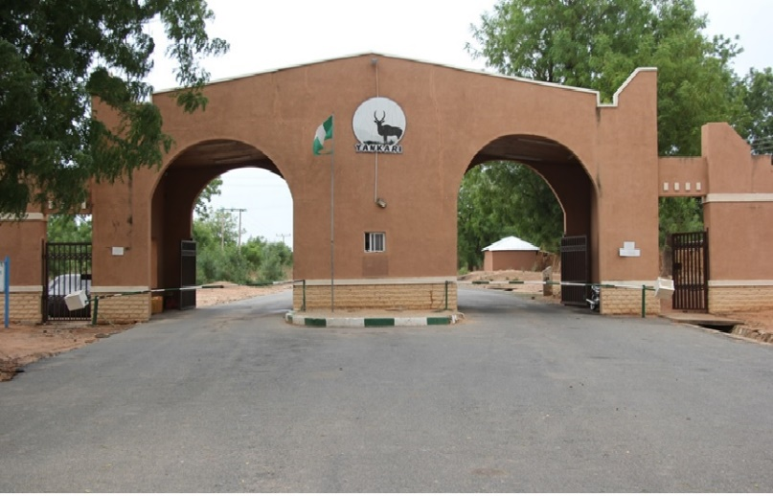
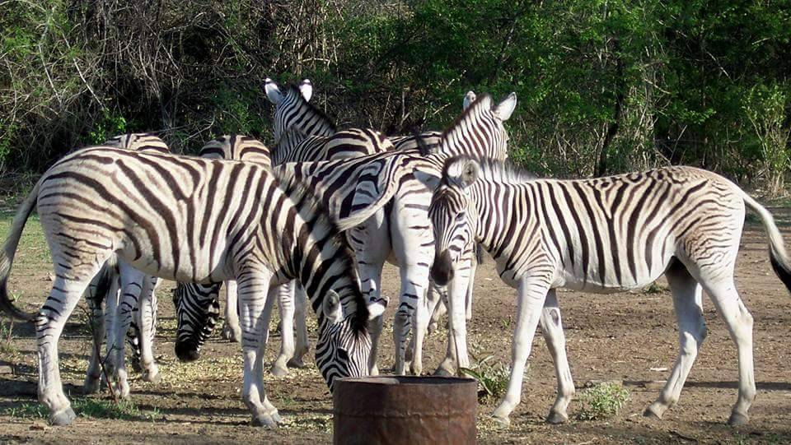
Wildlife Parks…
YANKARI RESORT AND SAFARI
SUMU WILD PARK
Bauchi State Nigeria
“Expanding the Frontiers of Leisure…
Notes:
An investment window

Slide 25
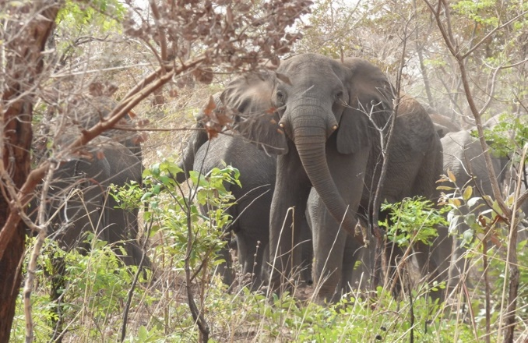
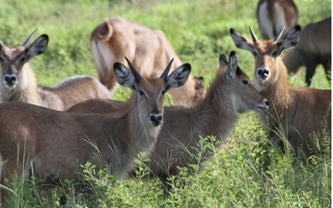
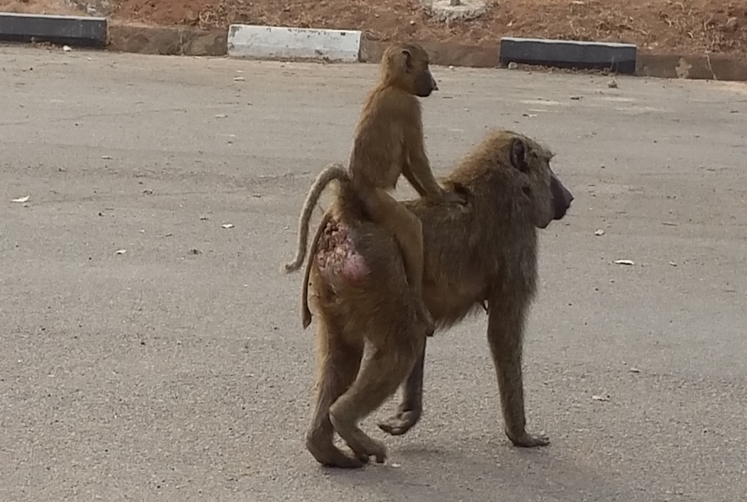
TOURISM SECTOR…..
YANKARI RESORT AND SAFARI
Some of the wildlife at the Reserve are pictured below:

Slide 26
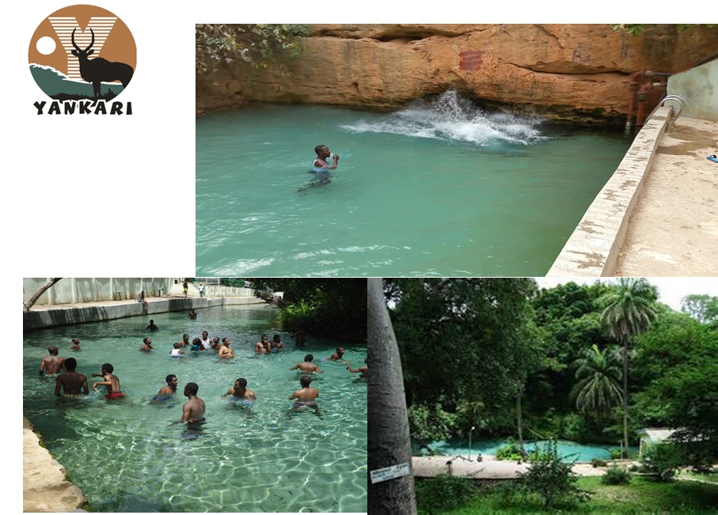
Wikki Warm Spring @ 31°C

Slide 27
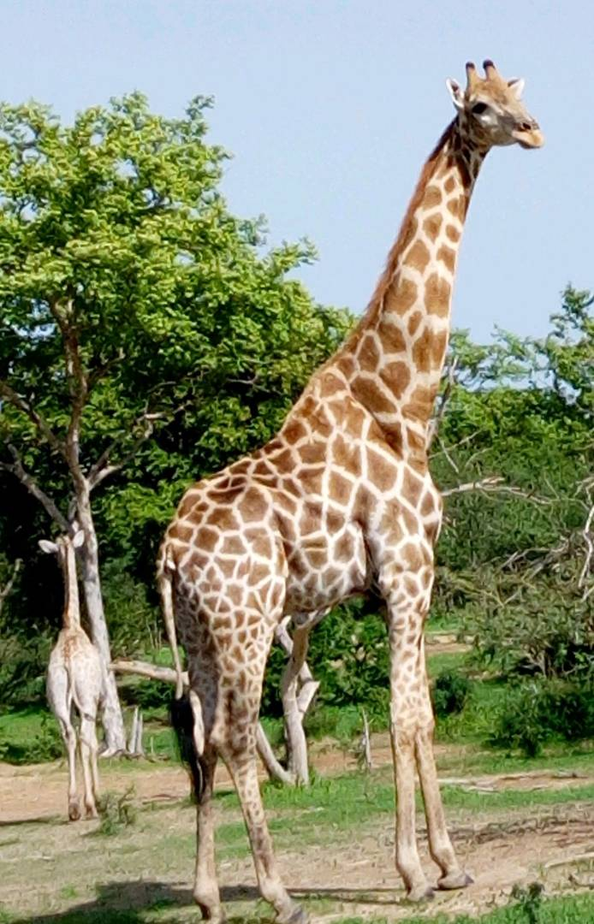
Zebra
Giraffe

Slide 28
TOURISM SECTOR….. iii. Key sectoral incentive on Hospitality/Tourism
25% of Income in convertible currencies exempted from tax
All other incentives applicable to the other sectors apply also to the tourism sector of the State

Slide 29
Finally
Bauchi State is ready for business and welcomes private investors willing to invest in any sector of the State’s economy
THANK YOU.

Slide 30
Governor’s Office,
P.M.B. 0208 Bauchi, Bauchi state Nigeria.
Email: ssgofficebauchi@gmail.com
Phone: +234 8067521096, +234 8098833179
For engagement, please contact:
Group Managing Director
Bauchi Investment Corporation.
Email: attahirms@yahoo.com
Phone: +234 8036291318 , +234 80559651318
For more details visit our website:
www.investinbauchi.bu.gov.ng
Notes:
THANK YOU

